Slide 1

Sportec Solutuions / Deltatre Working Student Interview
Abhinav Ralhan • 09.09.2022

Slide 2
Task
Task
Using the available tracking data, find which areas of the football pitch the ball possessing players are under most pressure from opponents.
Your results should be visualized appropriately and your solution should be well documented.
In order to solve the task, you have to come up with sensible but quick and approximate working definitions of ball possession and pressure that are easy to implement but also make sense from a football perspective.

Slide 3


Personas
User-Player
Player needs to know high pressing areas of opposing team, in order to avoid possession loss for his team.
Player needs to know when to engage in a press, in order to create turnovers for his/her team.
User-Coach
Coach needs to identify areas where his team can lose / gain possession and communicate it to his/her players.
Coach needs to identify / develop a pressing plan in order to advance the ball to higher areas of the pitch.

Slide 4
Definitions / Assumptions
Ball possession
In this case study solution, a team is said to be in ball possession in the given frame depending on value assigned to variable BallPossession.
In general, as estimate can be computed for the entire game by calculating
# of frames associated to a team / # of total frames available.
Pressure areas
Attacker: A player of the team in ball possession.
Defender: Player from the team not in ball possession.
When there are 3+ defenders with 3+ attackers in < 5m of the ball AND 1 defender < 4m of the ball, it can be called organised pressing / pressure area.
Not considering the final third to be the only pressing area.

Slide 5
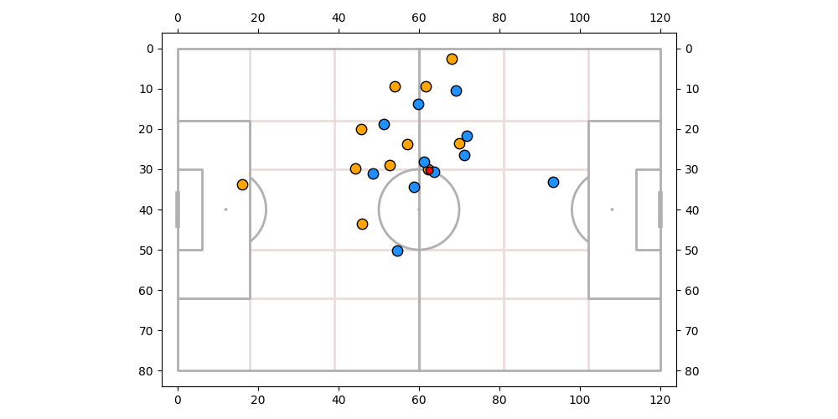
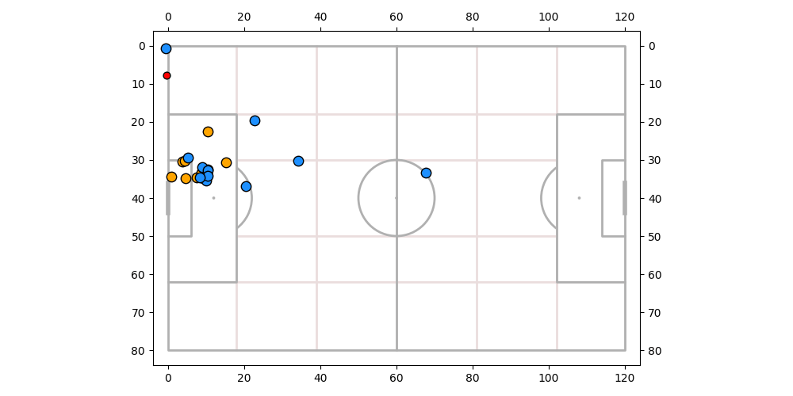
Team 1 (Orange) Pressing Action Samples

Slide 6
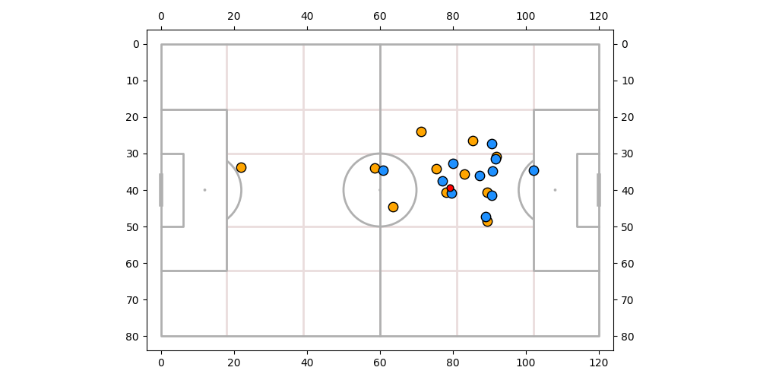
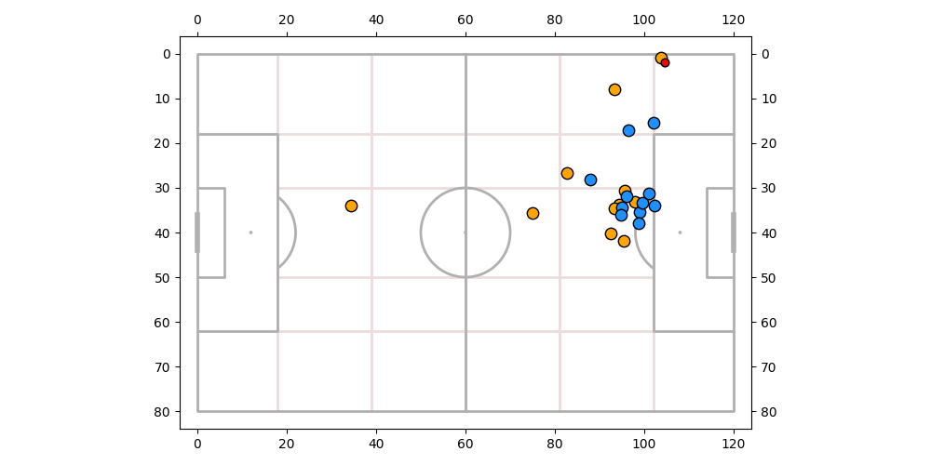
Team 2 (Blue) Pressing Action Samples

Slide 7
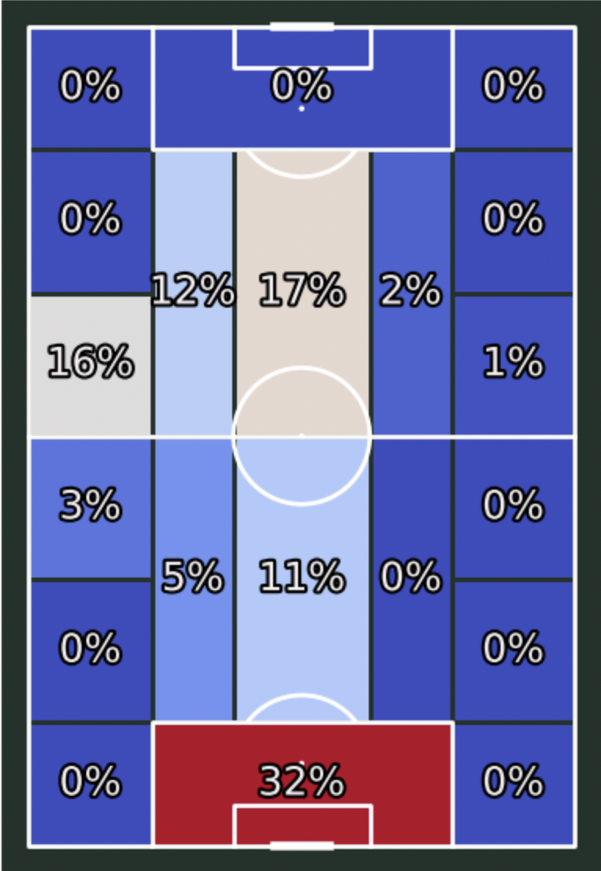
Team 1 (Orange) Pressing Zones

Slide 8
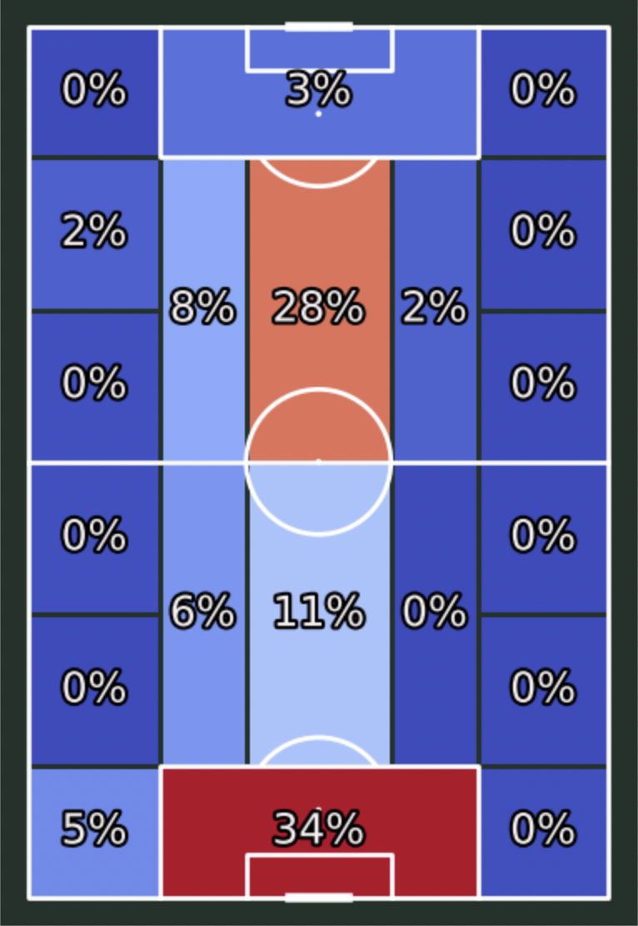
Team 2 (Blue) Pressing Zones

Slide 9
Final Thoughts
A lot of duels were fought in Team1's penalty box and in central areas of the pitch.
Team1 likes pressing from the front especially in the left wing / striker zones. And, high % defensive actions in their own box.
Team2 have heavy pressing actions in their own half and primarily central zones. Also, pressures seen in opposition box.
Team2 has more examples of pressing scenarios than team.
Found a lot more dead ball situations than I had expected in high pressure situations.

Slide 10
Relevant Metrics
Turnovers.
Shots post successful pressures. (from defending team)
PPDA. (Passes per Defensive Actions)
References
MPL Soccer python package
Statsbomb
Soccermatics
Stats Perform

